Slide 1
IT 106: Introduction to IT Problem Solving Using Computer Programming
Module 3a
Problem Solving with Selection Control Structures and Decision Statements

Slide 2
In This Lecture
Selection Control With IF Statements
Algorithm Using Selection
Selection Control With CASE Statements
Flowcharting

Slide 3
Questions?

Slide 4
Selection Control With IF Statements

Slide 5
Overview
Selection control structures represent the decision making capability of a computer
Illustrates how decisions can be made when presented with two or more options
Based on the evaluation if a condition, which yields a boolean value
True
False
Works with relational operators, such as <, >

Slide 6
Overview (Cont'd)
The condition in the IF statement is based on a comparison of two items and it is expressed with the following relational operations:
< - less than
> - greater than
= - equal to
<= - less than or equal to
>= - greater than or equal to
<> - not equal to

Slide 7
Overview (Cont'd)
There are a number of variations of the selection structure
Simple selection (simple IF/ELSE statement)
Simple selection with null false branches (no ELSE statement)
Combined selection (combined IF statement)
Nested selection (nested IF statement)

Slide 8
Simple Selection (simple IF statement)
Simple selection occurs when a choice is made between two alternate paths depending on the result of a condition being true or false
Psuedocode keywords: IF, THEN, ELSE, ENDIF
Example:
IF account_balance < $300 THEN
service_charge = $5.00
ELSE
service_charge = $2.00
END IF

Slide 9
Simple Selection with Null False Branches (No Else Statement)
The NULL else statement means that it simply doesn't exist
Used when a task should be performed only when a particular condition is true
Nothing will happen if the condition is false
Psuedocode keywords: IF, THEN, ENDIF
Example:
IF course_overload = TRUE THEN
student_surcharge = $500
ENDIF

Slide 10
Combined Selection (Combined IF Statement)
Uses an IF statement with AND or OR connector to test multiple conditions
Psuedocode keywords: IF, THEN, OR, AND, NOT, ENDIF
Example (Using AND)
IF course_overload = TRUE AND resident_state <> 'VA' THEN
student_surcharge = $500
ENDIF
This surcharge will only go through if the student has a course overload AND is not a resident of VA
If either condition is found to be false, the surcharge will not occur

Slide 11
Combined Selection (Combined IF Statement) (Cont'd)
Uses an IF statement with AND or OR connector to test multiple conditions
Psuedocode keywords: IF, THEN, OR, AND, ENDIF
Example (Using OR)
IF course_overload = TRUE OR resident_state <> 'VA' THEN
student_surcharge = $500
ENDIF
This surcharge will go through if the student has a course overload OR is not a resident of VA
If either condition is found to be true, the surcharge will not

Slide 12
Combined Selection (Combined IF Statement) (Cont'd)
More than two conditions can be linked together with the AND or OR operators
Example
IF (course_overload = TRUE AND resident_state <> 'VA') OR student_level = 'Graduate' THEN
student_surcharge = $500
ENDIF
This surcharge will go through if the student has a course overload AND is not a resident of VA, or if the student is a graduate student
Note: The parentheses here are required to help avoid ambiguity

Slide 13
Combined Selection (Combined IF Statement) (Cont'd)
The NOT operator can be used for the logical negation of a condition
Example
IF NOT (record_code = '23') THEN
Update customer record
ENDIF
The customer record will be updated if the record code is not equal to 23.
The AND and OR operators can also be used with the NOT operator, but great care must be taken while incorporating parentheses to avoid ambiguity

Slide 14
Nested Selection (Nested IF Statement)
This type of IF statement can be classified as:
Linear nested IF statements
Non-linear nested IF statements
Linear nested IF statements are used when a field is being tested for various values and the action taken is based on one of those values

Slide 15
Nested Selection (Nested IF Statement) (Cont'd)
Linear nested IF statement
Each ELSE immediately follows the IF condition to which it corresponds
Example:
IF record_code = 'A' THEN
increment counter_A
ELSE
IF record_code = 'B' THEN
increment counter_B
ELSE
increment error_counter
END IF
END IF
Notes
There are an equal number of IF, ELSE, and ENDIFs
Indentation helps make the pseudocode much easier to read and understand

Slide 16
Nested Selection (Nested IF Statement) (Cont'd)
Non-linear nested IF statement
A number of different conditions need to be satisfied before a particular action can occur
The ELSE statement may be separated from the IF statement with which it is paired
Example:
IF student_attendance = 'part_time' THEN
IF student_gender = 'female' THEN
IF student_age > 21 THEN
add 1 to mature_female_pt_students
ELSE
add 1 to young_female_pt_students
ENDIF
ELSE
add 1 to male_pt_students
ENDIF
ELSE
add 1 to full_time_students
ENDIF
Notes
There are an equal number of IF, ELSE, and ENDIFs
Indentation helps make the pseudocode much easier to read and understand

Slide 17
Questions?

Slide 18
Problem Solving Using Selection Controls

Slide 19
Example 1: Defining the Problem
Problem Scenario
A program is required to read a customer's name, a purchase amount, and a tax code.
You may assume the tax code has been validated and will be one of the following:
0 tax exempt (0%)
1 state sales tax only (3%)
2 federal and state sales tax (5%)
3 special sales tax (7%)
The program must calculate the sales tax and the total amount due. It must then print the customer's name, purchase amount, sales tax, and total amount due
What do we do now?

Slide 20
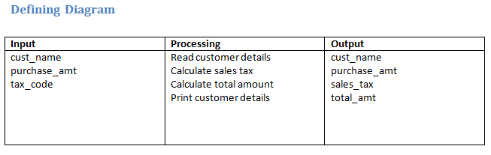
Example 1: Defining the Problem
Define the inputs, processes, and outputs
Remember the defining algorithm shows what is required

Slide 21
Example 1: Creating the Solution Algorithm
Remember the solution algorithm shows how the input is processed to achieve the output
We can use a linear nested IF statement
PROCESS_CUSTOMER_RECORD
1 Read cust_name, purchase_amt, tax_code
2 IF tax_code = 0 THEN
sales_tax = 0
ELSE
IF tax_code = 1 THEN
sales_tax = purchase_amt * 0.03
ELSE
IF tax_code = 2 THEN
sales_tax = purchase_amt * 0.05
ELSE
sales_tax = purchase_amt * 0.07
ENDIF
ENDIF
ENDIF
3 total_amt = purchase_amt + sales_tax
4 Print cust_name, purcahse_amt, sales_tax, total_amt
END

Slide 22
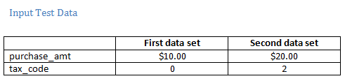
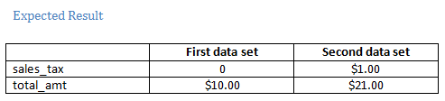
Example 1: Desk Checking – Test Data
Note: Consider if two data sets are enough. There are 4 different tax codes

Slide 23
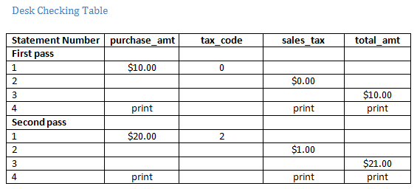
Example 1: Desk Checking – Testing Result

Slide 24
Questions?

Slide 25
Selection Control With CASE Statements

Slide 26
The CASE Structure
A linear nested IF structure can be replaced with a case control structure
Simplifies the selection control structure by removing all of the IF/ELSE statements and allows a selection from multiple values
Psuedocode keywords: CASE OF, ENDCASE

Slide 27
CASE Example
We can simplify the previous example through the use of a CASE statement
PROCESS_CUSTOMER_RECORD
1 Read cust_name, purchase_amt, tax_code
2 CASE OF tax_code
0 : sales_tax = 0
1 : sales_tax = purcahse_amt * 0.03
2 : sales_tax = purcahse_amt * 0.05
3 : sales_tax = purcahse_amt * 0.07
ENDCASE
3 total_amt = purchase_amt + sales_tax
4 Print cust_name, purcahse_amt, sales_tax,
total_amt
END

Slide 28
Questions?

Slide 29
Flowcharting

Slide 30
Flowcharting
Flowcharting is another tool you can use to help understand the processing of a program
Not a replacement for pseudocode!
Also useful when explaining business process to end users

Slide 31
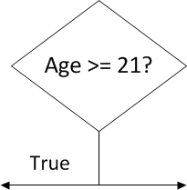
Flowcharting Symbols
Oval – Starting/Ending Point
Box – signifies a statement, such as variable assignment
Diamond – condition/branch
Arrows – show the flow of the program

Slide 32
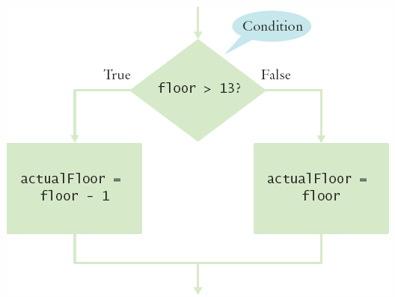
Flowcharting an if Statement
Example: Elevators often skip the 13th floor, even though a building does have a 13th floor
So, the 14th floor is really the 13th floor
Every floor above 12 is really, "floor – 1"

Slide 33
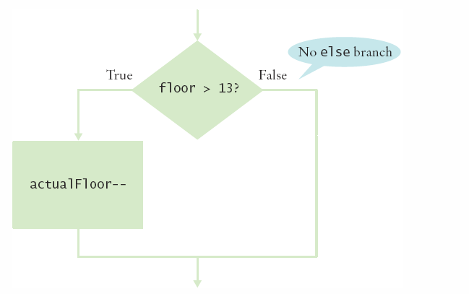
Flowcharting with Only True Branch
An IF statement may not necessarily need a False (else) branch

Slide 34
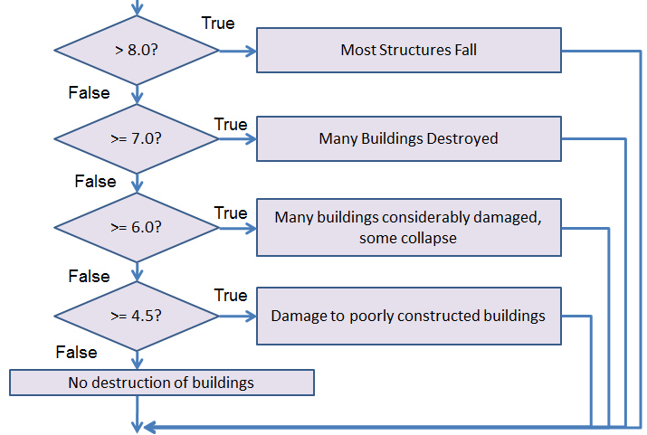
Flowchart of Multi-way Branching
Flowcharting can also be used when one decision out of many has to be made

Slide 35
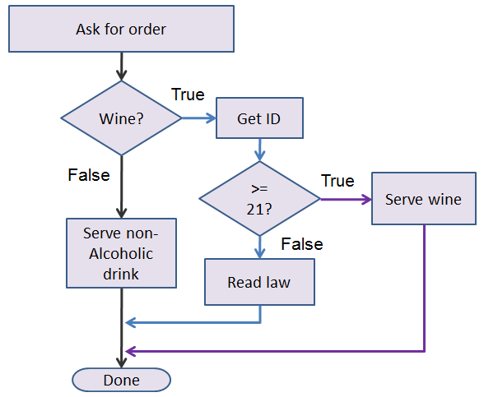
Flowcharting with Nested If
Three possible paths (denoted by color)

Slide 36
Practice Problem
Scenario
You have been asked to create a program that allows the user to input two integers and then displays their sum, difference, product, and quotient with a message for each (e.g. The sum is). The quotient calculation should only be performed if the second integer does not equal zero. The user should be informed if an error occurs.
To Do:
Create a defining diagram
Create a solution algorithm using pseudocode
Check the solution algorithm by using the desk checking table method

